Slide 1

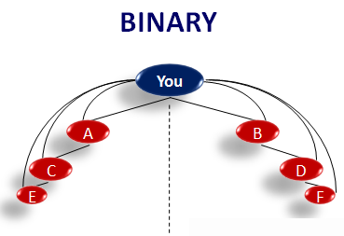
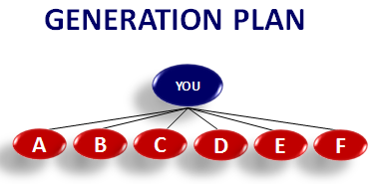

MARKETING PLAN

Slide 2
Dreams
Your INCOME
House(small, bungalow)
Car(small, big, BMW)
Expected
Actual
Jewelry , Accessories
World Tour
Better Education
Compromise ??
Name & Fame
Charity & Social service
Others…
Financial Freedom = [ Enough Money + Enough Time ]

Slide 3






Awards
Rewards
WEEKLY INCOME
RETAIL PROFIT
Up to 1,30,000/ week
LIFE TIME AWARDS
PERFORMANCE BONUS
Up to Rs.20,00,000/-
PERFORMACE AWARDS
DIRECTOR BONUS
Up to Rs.1 CRORE
REGIONAL TRAININGS
LEADERSHIP BONUS
INTERNATIONAL TRIPS
TOTAL BONUS

Slide 4

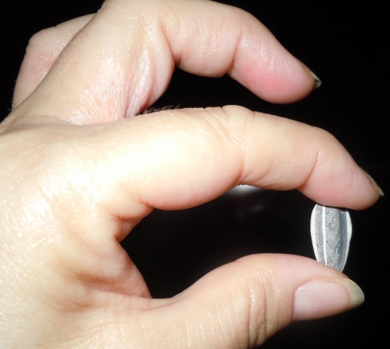

Slide 5
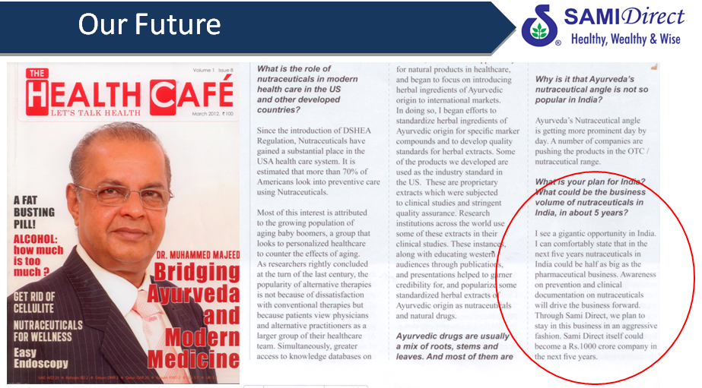
NEXT 5 YEARS SAMI DIRECT IS COMMITTED TO BECOME A 1000 CRORE COMPANY

Slide 6




Slide 7
How Does this business work ??
30%
70%
Product
Manufacturing cost
YOU
+
YOUR Network
Marketing Expenses
(Advertisements)
(Brand ambassadors)
(stockiest)
(wholesalers)
(retailers) etc…
M R P

Slide 8
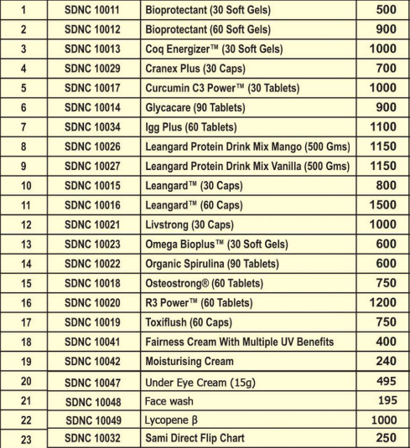
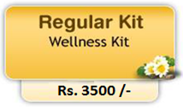
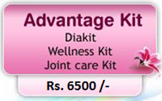
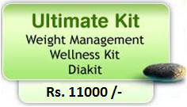
P
LAN
How to Become Our Distributor?

Slide 9
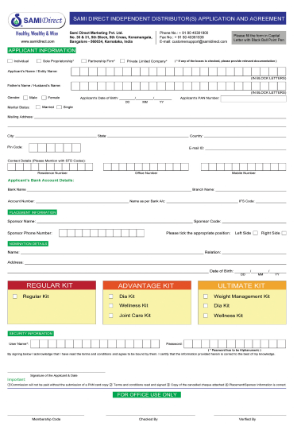
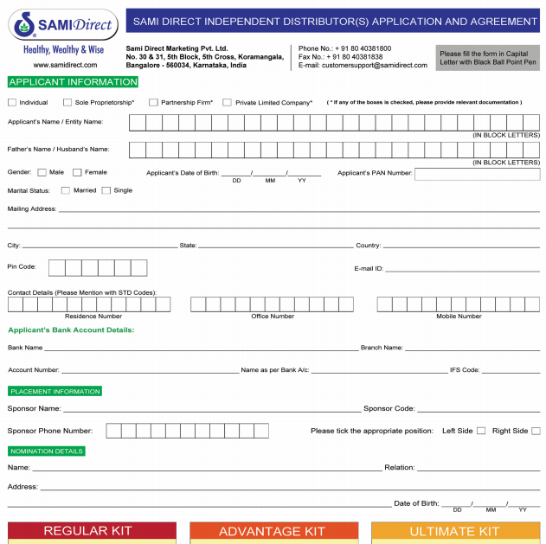



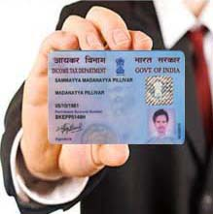
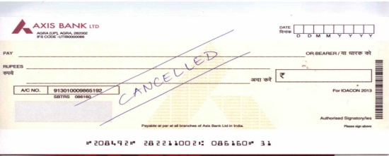

Slide 10
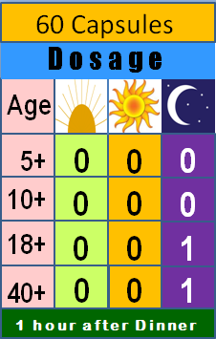




*TOXIFLUSH - ACTIONS & BENEFITS
Supports the body’s natural mechanisms to eliminate toxins
Supports healthy digestion
Supports the maintenance of normal liver functions
* 1 capsule daily night for 30 days & repeat after 4 months.
MRP: Rs.900
DP-Rs.750
20 Servings
LEANGARD PROTEIN DRINK (IDEAL BREAKFAST)
It is an IDEAL PROTEIN-RICH COMPLETE MEAL.
Helps in CALORIE MANAGEMENT
Contains ESSENTIAL MICRONUTRIENTS
Contains unique DIGESTIVE INTOLERANCE BLEND (DIB)
MRP: Rs.1350
IDEAL BREAKFAST
DP-Rs.1150

Slide 11
P
Get the Benefit of TWO income plans
LAN
BINARY
GENERATION PLAN
Left
Right
You
YOU
A
B
A
B
C
D
E
F
C
H
D
H
I
G
K
L
M
N
E
G
I
J
F
J
K
L
M
N

Slide 12


BINARY INCOME
Points
Weekly Ceiling
Weekly Closing
1st - 7th
35,000
30
8th - 14th
15th - 21st
75,000
22nd - month end
60
1,30,000
110

Slide 13
P
Weekly Income to meet your expenses
LAN
BINARY
points
You
30
A
B
60 Pts
110 Pts
C
30 Pts
60
Total Pair Points =90
Total Pair Points =110
Matching Pairs = 90 left : 90 right (20 Pts Carry Fwd)
110
1 Point pair value = Rs.10
TOTAL INCOME = 90 x 10 = RS. 900 /-

Slide 14

P
ULTIMATE – RS.11000 = 110 P
LAN
ADVANTAGE – RS.6500 = 60 P
ILLUSTRATION
REGULAR -- RS.3500 = 30 P
You
1 Pair Point value = Rs.10
110
60
35,000
60
60
60
110
30
60
30
110
30
110
60
60
75,000
Total Pair Points =4600
Total Pair Points =4900
Pairs Paid = 4600 left : 4600 right = 4600 points
1,30,000
Carry forward = 300 points
Pair Income = 4600 x10 = Rs.46000

Slide 15
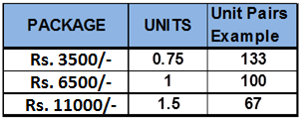
P
Rewards Unlimited !!
LAN

Slide 16



P
Deductions
LAN
REPURCHASE 10%
(max Rs.1600/month)
10% (TDS)
2% (max Rs.100)

Slide 17



P
Generation Income
LAN
BINARY
GENERATION PLAN
You
YOU
A
B
A
B
C
D
E
F
C
D
Minimum Monthly maintenance of 640 BV equivalent to Rs.1600
E
F
NO MONTHLY REPURCHASE

Slide 18
P
9 Unique Profits
LAN

Slide 19

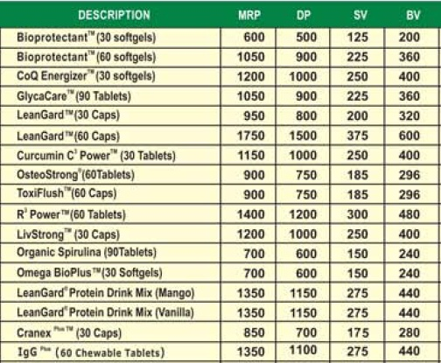
P
LAN
Personal Repurchase Bonus (Earn 20% of BV)
Monthly Repurchase
(min Rs. 1600)

Slide 20
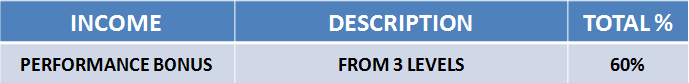
DISTRBUTOR PRICE | BV
RS.1000 | 400
1600 Rs
YOU
20 % of your personal monthly repurchase (BV).
8%
20 % of your 1st level monthly repurchase (BV).
8%
A
B
C
D
E
F
10 % of your 2nd level monthly repurchase (BV).
4%
10 % of your 3rd level monthly repurchase (BV).
4%
24%

Slide 21
P
Director Achievement Bonus Qualification Chart
LAN

Slide 22

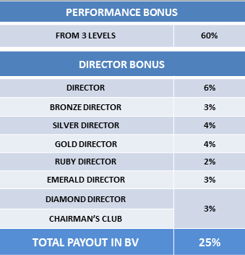
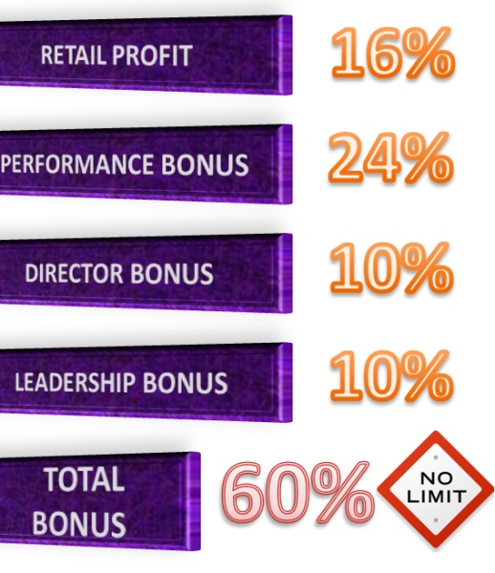
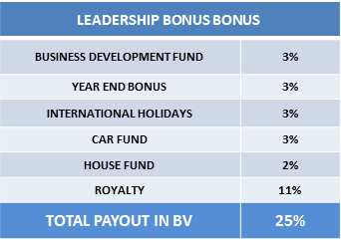
P
LAN
Chairman’s Club (3 Diamond Director Lines)
CHAIRMAN’S
CLUB
DIAMOND
DIRECTOR
DIAMOND
DIRECTOR
DIAMOND
DIRECTOR

Slide 23

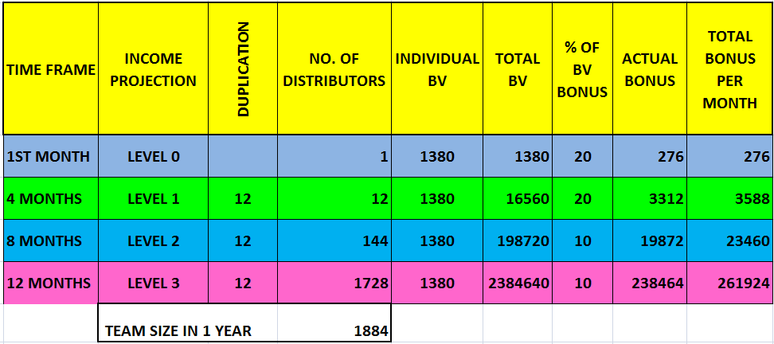
Rs.3450
1380 BV
DP-Rs.1150
DP-Rs.1150
DP-Rs.1150

Slide 24


Slide 25
What you should do next…?
DECISION - Subscribe for the Joining Package
Cash/ Credit Card/Debit Card for payment
Use the Products & Experience the Benefits
SHARE OPPORTUNITY WITH OTHERS

